Slide 1






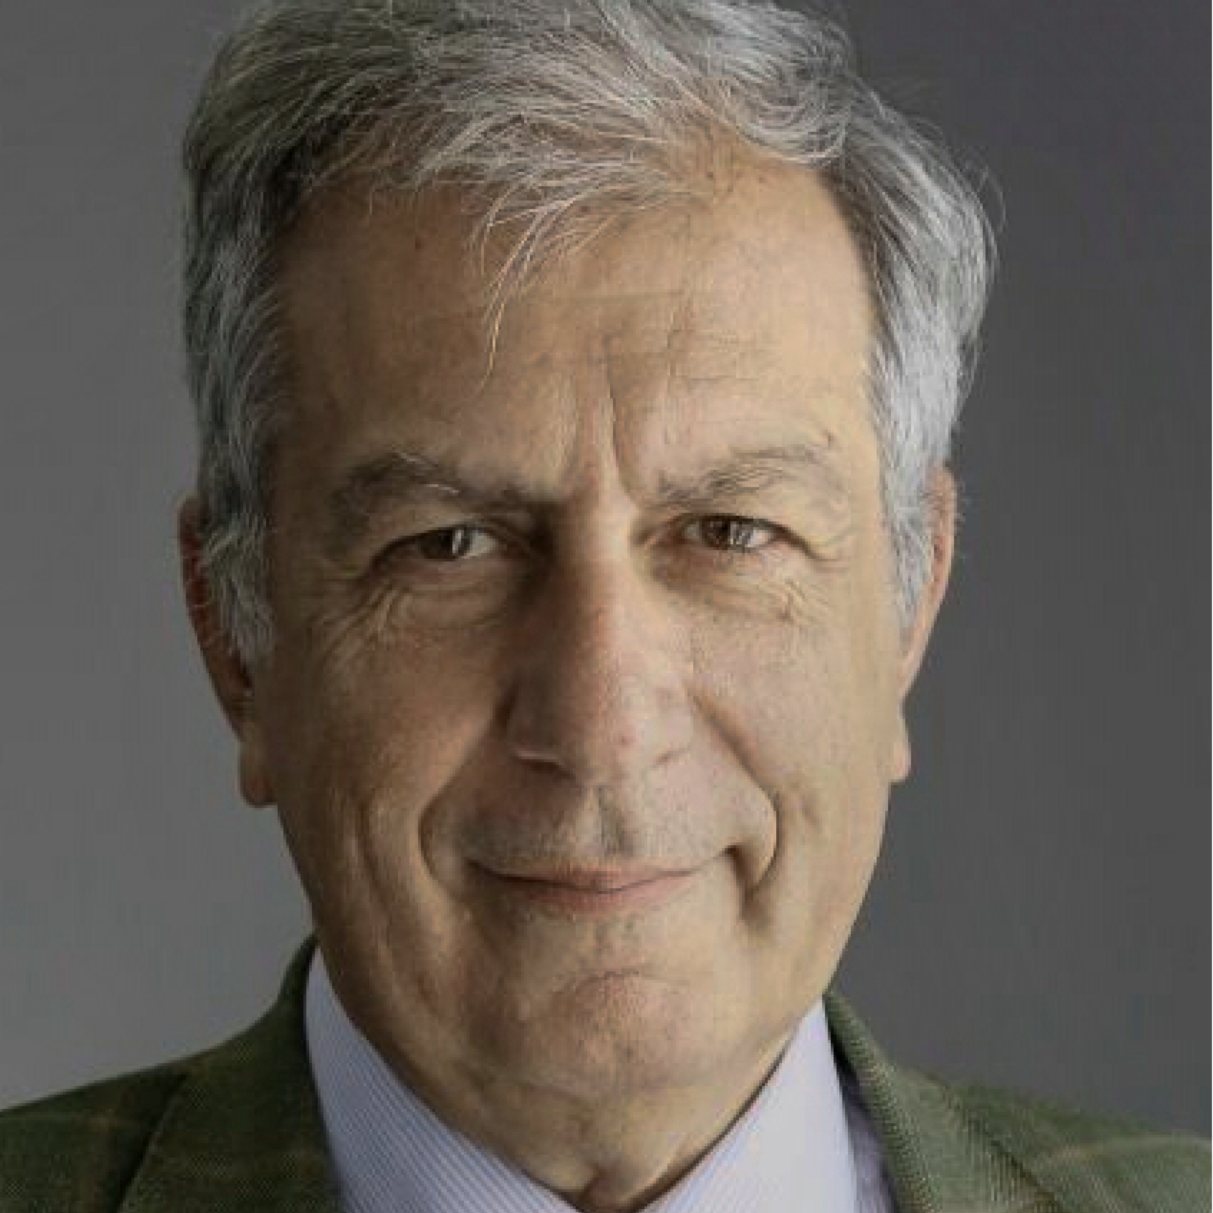
Zero-Shot Composed Image Retrieval With Textual Inversion
Alberto Baldrati*
Lorenzo Agnolucci*
Marco Bertini
Alberto Del Bimbo
MICC – University of Florence, Italy
International Conference on Computer Vision 2023 (ICCV2023)
*Equal Contribution

Slide 2
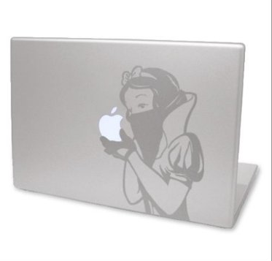
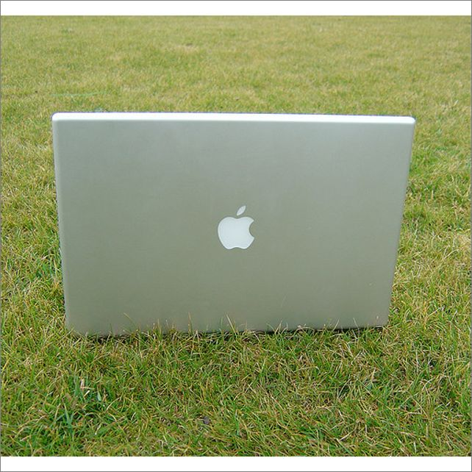
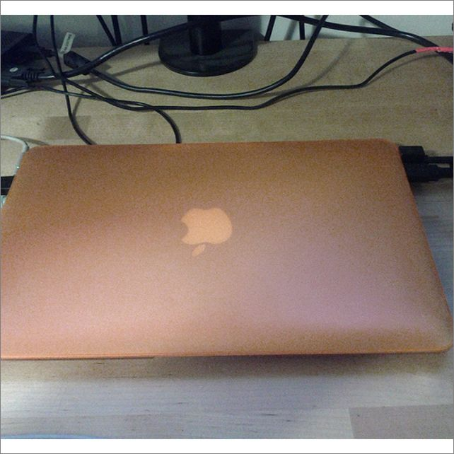
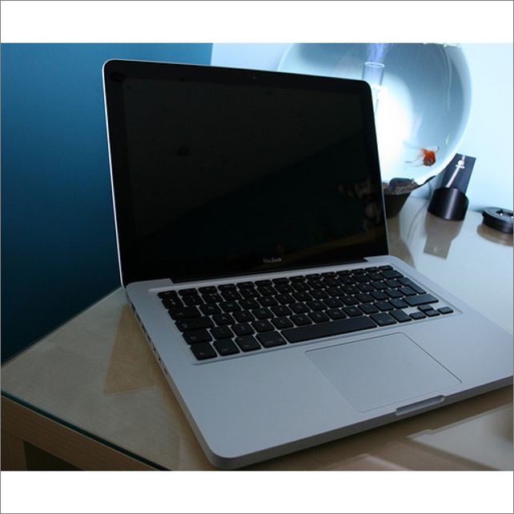

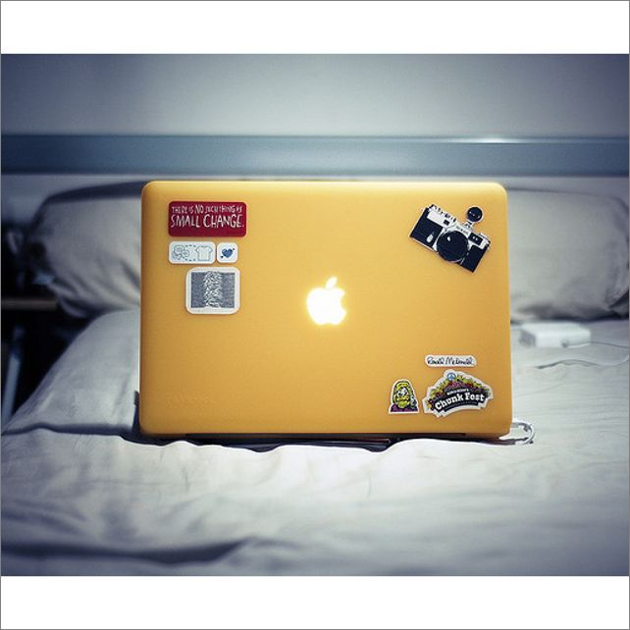
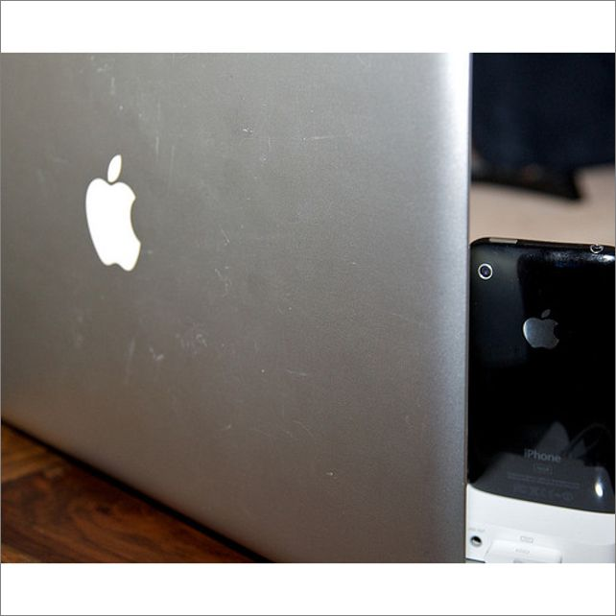
Composed Image Retrieval (CIR)
📸🔍 In CIR, the goal is to find images that closely match the query image while incorporating the changes described in the caption.
Query
Gallery
has a different color and more stickers

Slide 3
Composed Image Retrieval (CIR)
📸🔍 In CIR, the goal is to find images that closely match the query image while incorporating the changes described in the caption.
Query
Answer
has a different color and more stickers

Slide 4
Motivations and Contributions
❌ Current Limitations
Existing methods for CIR rely on supervised learning, which requires expensive and time-consuming manual data labeling
Existing CIR datasets contain several false negatives, i.e., images that could be potential ground truths for the query but are not labeled as such
💡 Contributions
We propose SEARLE, a CLIP-based method that addresses CIR in a zero-shot manner, thus without requiring a labeled training dataset
We introduce CIRCO, an open-domain benchmarking dataset for CIR with multiple annotated ground truths and reduced false negatives

Slide 5
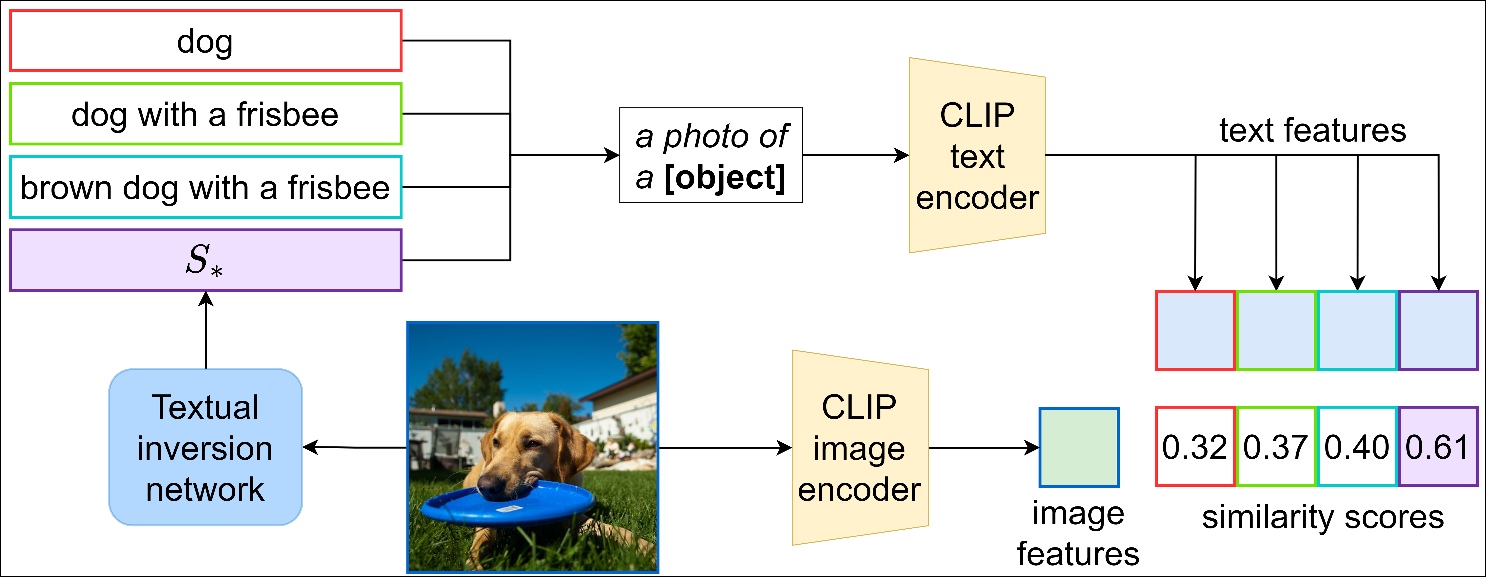
Textual Inversion
Gal, Rinon, et al. "An Image is Worth One Word: Personalizing Text-to-Image Generation using Textual Inversion." The Eleventh International Conference on Learning Representations. 2022.

Slide 6
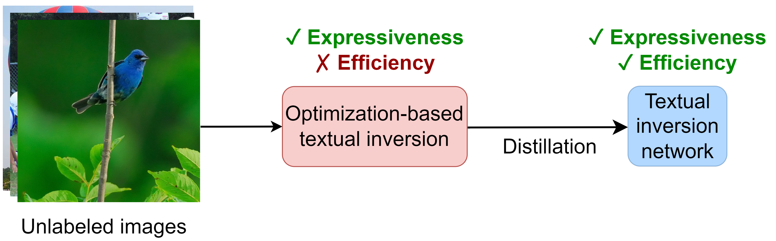
SEARLE Training Overview
Given an unlabeled dataset, SEARLE training involves two stages:
Step 1:
An iterative Optimization-based Textual Inversion (OTI) to generate a pseudo-word token per image
Step 2:
The training of a textual inversion network φ by distilling the knowledge embedded in pre-generated tokens
Step 1:
An iterative Optimization-based Textual Inversion (OTI) to generate a pseudo-word token per image
Step 2:
The training of a textual inversion network φ by distilling the knowledge embedded in pre-generated tokens

Slide 7
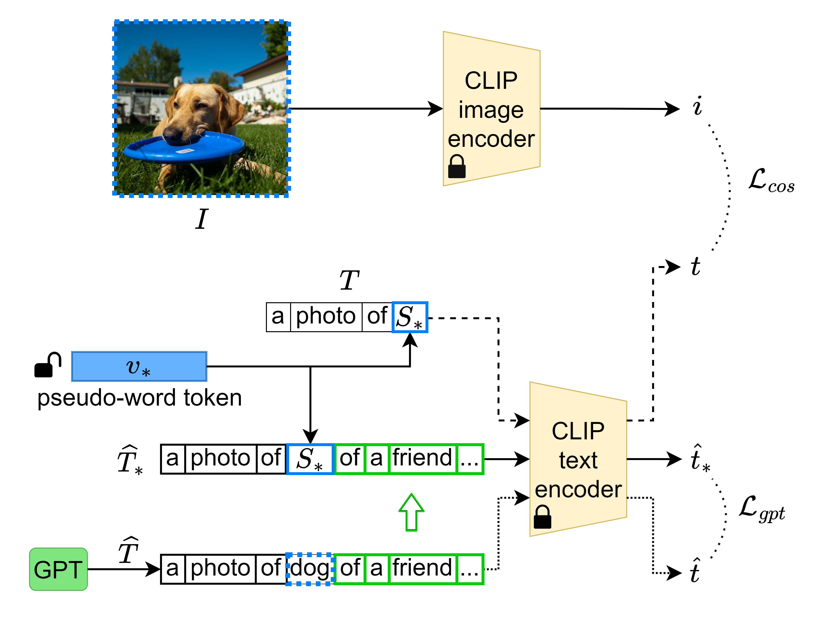
SEARLE Training: OTI
Step 1:
We employ an Optimization-based Textual inversion (OTI) to iteratively generate a pseudo-word token per image from an unlabeled dataset

Slide 8
SEARLE Training: OTI
Step 1:
We employ an Optimization-based Textual inversion (OTI) to iteratively generate a pseudo-word token per image from an unlabeled dataset

Slide 9
SEARLE Training: OTI
Step 1:
We employ an Optimization-based Textual inversion (OTI) to iteratively generate a pseudo-word token per image from an unlabeled dataset

Slide 10
SEARLE Training: OTI
Step 1:
We employ an Optimization-based Textual inversion (OTI) to iteratively generate a pseudo-word token per image from an unlabeled dataset

Slide 11
SEARLE Training: OTI
Step 1:
We employ an Optimization-based Textual inversion (OTI) to iteratively generate a pseudo-word token per image from an unlabeled dataset

Slide 12
SEARLE Training: OTI
Step 1:
We employ an Optimization-based Textual inversion (OTI) to iteratively generate a pseudo-word token per image from an unlabeled dataset

Slide 13
SEARLE Training: OTI
Step 1:
We employ an Optimization-based Textual inversion (OTI) to iteratively generate a pseudo-word token per image from an unlabeled dataset
Encapsulates the informative content of I into v* by closing the gap between the image and text features

Slide 14
SEARLE Training: OTI
Step 1:
We employ an Optimization-based Textual inversion (OTI) to iteratively generate a pseudo-word token per image from an unlabeled dataset
Encapsulates the informative content of I into v* by closing the gap between the image and text features

Slide 15
SEARLE Training: OTI
Step 1:
We employ an Optimization-based Textual inversion (OTI) to iteratively generate a pseudo-word token per image from an unlabeled dataset
Encapsulates the informative content of I into v* by closing the gap between the image and text features

Slide 16
SEARLE Training: OTI
Step 1:
We employ an Optimization-based Textual inversion (OTI) to iteratively generate a pseudo-word token per image from an unlabeled dataset
Encapsulates the informative content of I into v* by closing the gap between the image and text features

Slide 17
SEARLE Training: OTI
Step 1:
We employ an Optimization-based Textual inversion (OTI) to iteratively generate a pseudo-word token per image from an unlabeled dataset
Encapsulates the informative content of I into v* by closing the gap between the image and text features

Slide 18
SEARLE Training: OTI
Step 1:
We employ an Optimization-based Textual inversion (OTI) to iteratively generate a pseudo-word token per image from an unlabeled dataset
Encapsulates the informative content of I into v* by closing the gap between the image and text features

Slide 19
SEARLE Training: OTI
Step 1:
We employ an Optimization-based Textual inversion (OTI) to iteratively generate a pseudo-word token per image from an unlabeled dataset
Encapsulates the informative content of I into v* by closing the gap between the image and text features

Slide 20
SEARLE Training: OTI
Step 1:
We employ an Optimization-based Textual inversion (OTI) to iteratively generate a pseudo-word token per image from an unlabeled dataset
Encapsulates the informative content of I into v* by closing the gap between the image and text features
Regularizes v* to make it capable of interacting with actual CLIP word tokens

Slide 21
SEARLE Training Overview
Given an unlabeled dataset, SEARLE training involves two stages:
Step 2:
The training of a textual inversion network φ by distilling the knowledge embedded in pre-generated tokens
Step 1:
An iterative Optimization-based Textual Inversion (OTI) to generate a pseudo-word token per image
Step 2:
The training of a textual inversion network φ by distilling the knowledge embedded in pre-generated tokens

Slide 22
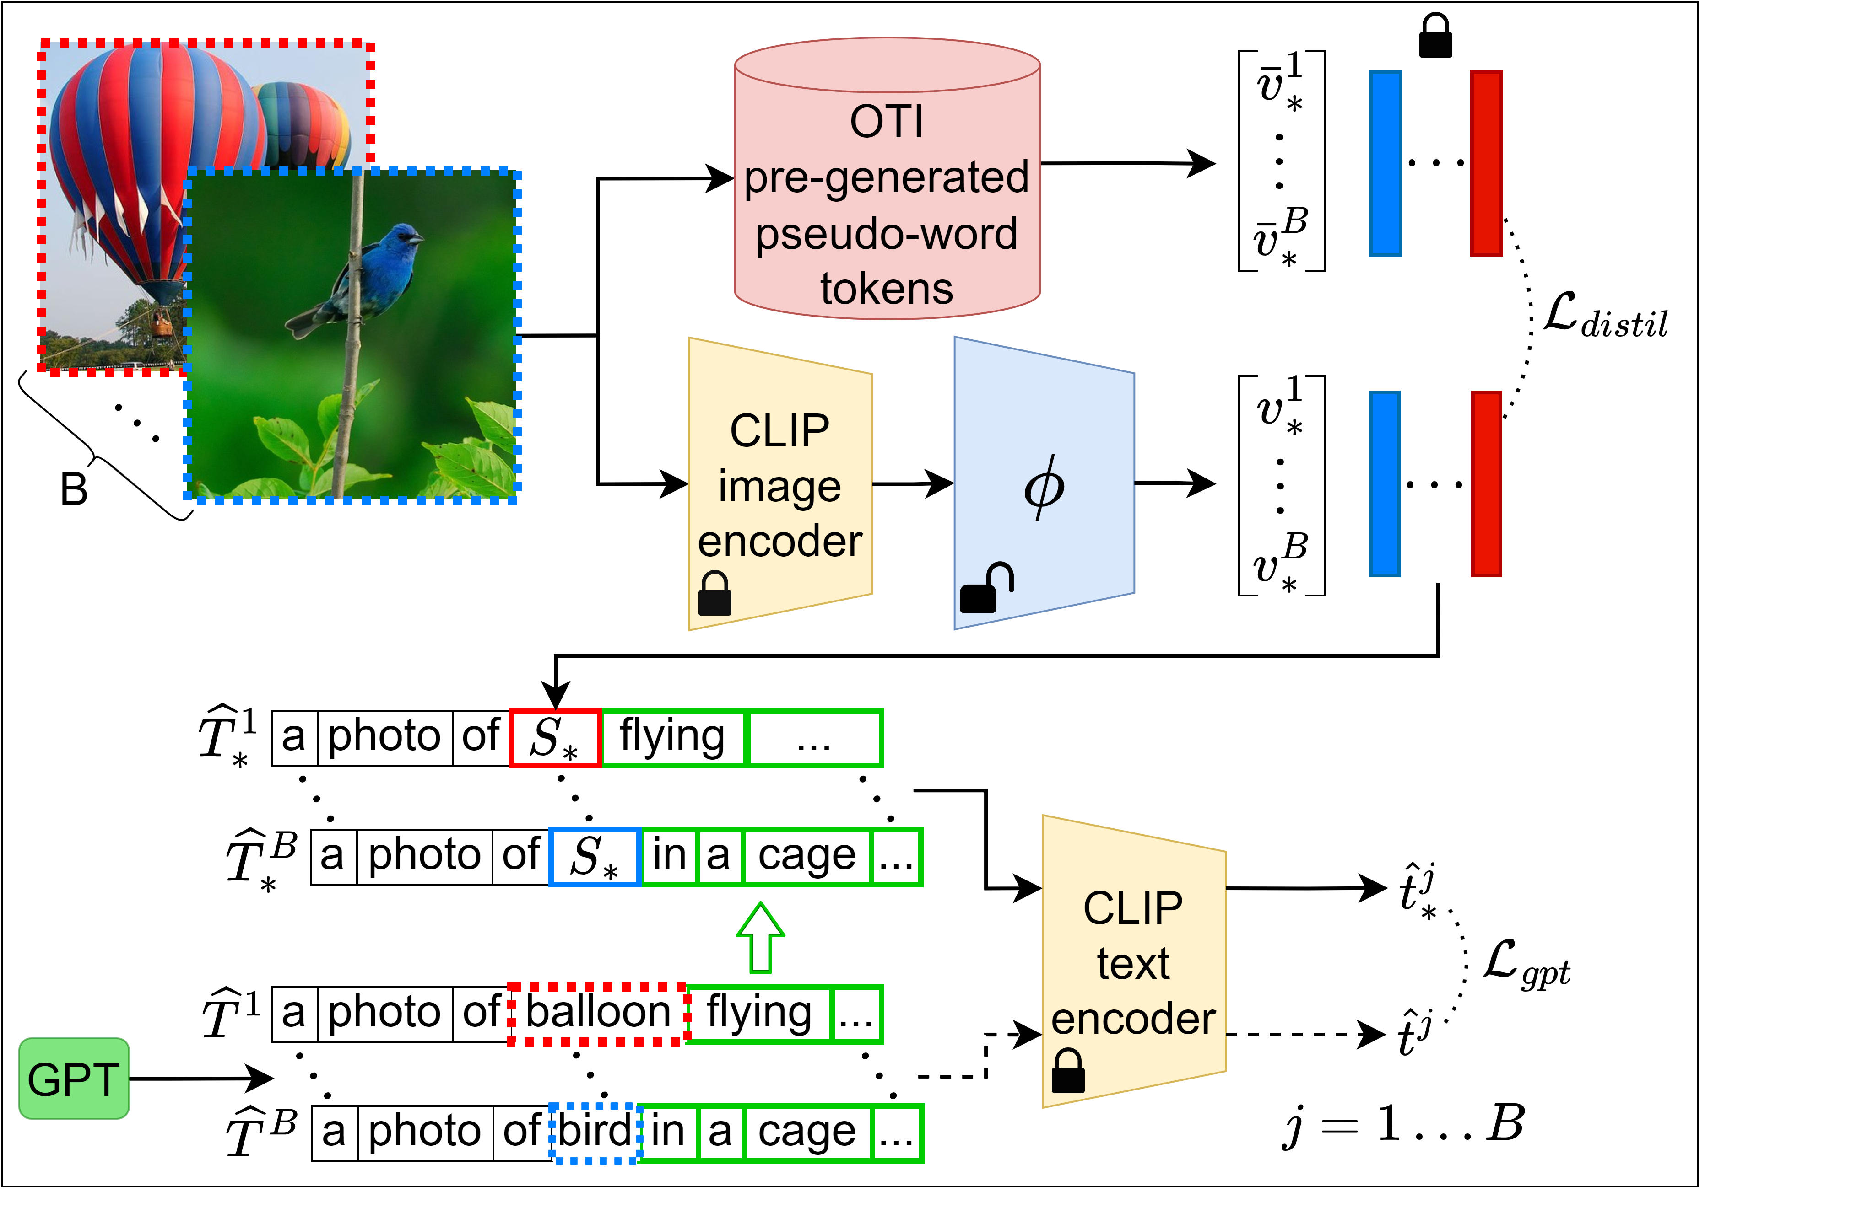
SEARLE Training: Textual Inversion Network
Step 2:
To retain the expressive power of OTI while achieving a negligible inference time, we train a network φ by distilling the knowledge embedded in the OTI pre-generated pseudo-word tokens

Slide 23
SEARLE Training: Textual Inversion Network
Step 2:
To retain the expressive power of OTI while achieving a negligible inference time, we train a network φ by distilling the knowledge embedded in the OTI pre-generated pseudo-word tokens

Slide 24
SEARLE Training: Textual Inversion Network
Step 2:
To retain the expressive power of OTI while achieving a negligible inference time, we train a network φ by distilling the knowledge embedded in the OTI pre-generated pseudo-word tokens

Slide 25
SEARLE Training: Textual Inversion Network
Step 2:
To retain the expressive power of OTI while achieving a negligible inference time, we train a network φ by distilling the knowledge embedded in the OTI pre-generated pseudo-word tokens

Slide 26
SEARLE Training: Textual Inversion Network
Step 2:
To retain the expressive power of OTI while achieving a negligible inference time, we train a network φ by distilling the knowledge embedded in the OTI pre-generated pseudo-word tokens

Slide 27
SEARLE Training: Textual Inversion Network
Step 2:
To retain the expressive power of OTI while achieving a negligible inference time, we train a network φ by distilling the knowledge embedded in the OTI pre-generated pseudo-word tokens
Minimizes the distance between the predicted pseudo-word token v* and its corresponding pre-generated token v̅*

Slide 28
SEARLE Training: Textual Inversion Network
Step 2:
To retain the expressive power of OTI while achieving a negligible inference time, we train a network φ by distilling the knowledge embedded in the OTI pre-generated pseudo-word tokens
Minimizes the distance between the predicted pseudo-word token v* and its corresponding pre-generated token v̅*
Regularizes v* to make it capable of interacting with actual CLIP word tokens

Slide 29
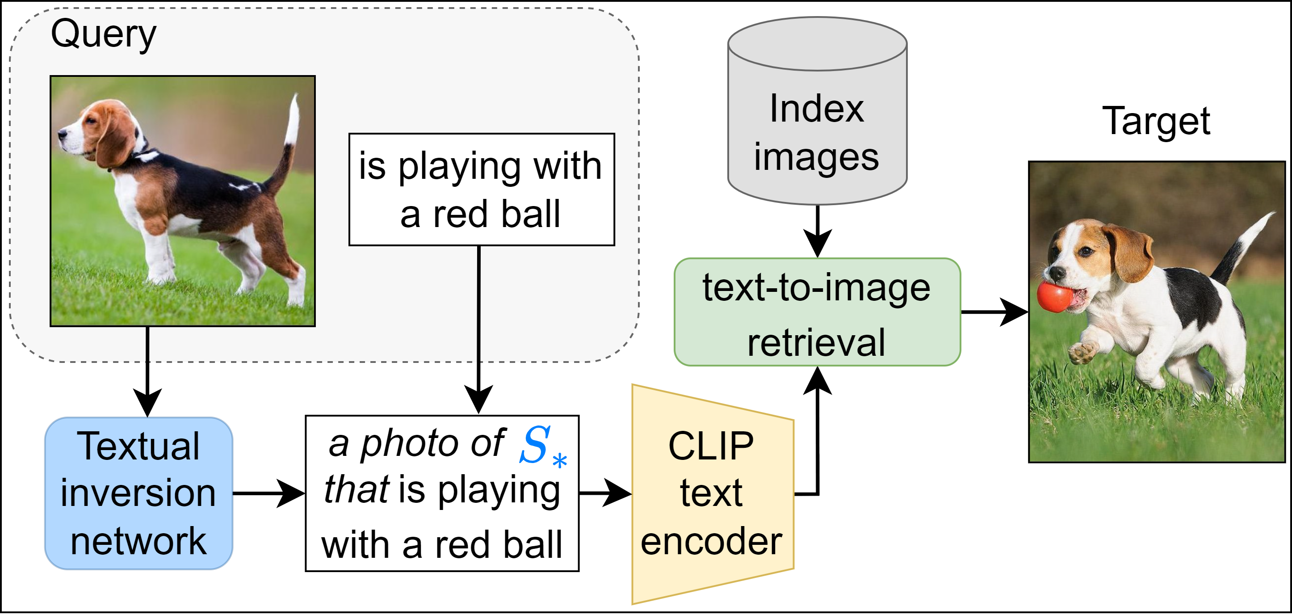
SEARLE Inference Time

Slide 30
SEARLE Inference Time

Slide 31
SEARLE Inference Time

Slide 32
SEARLE Inference Time

Slide 33
SEARLE Inference Time

Slide 34
SEARLE Inference Time

Slide 35
SEARLE Inference Time

Slide 36
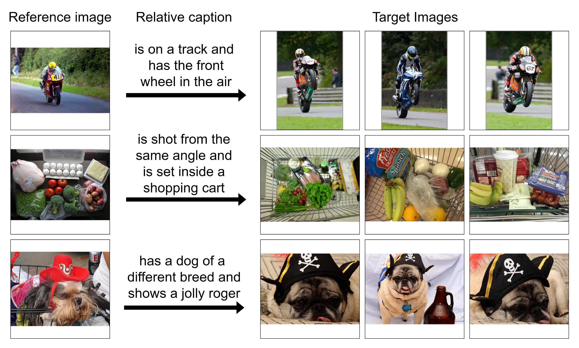
CIRCO Dataset
To support CIR research we introduce an open-domain dataset named CIRCO
CIRCO is the first CIR dataset with multiple annotated ground truths
To ease the annotation process we propose to leverage SEARLE

Slide 37
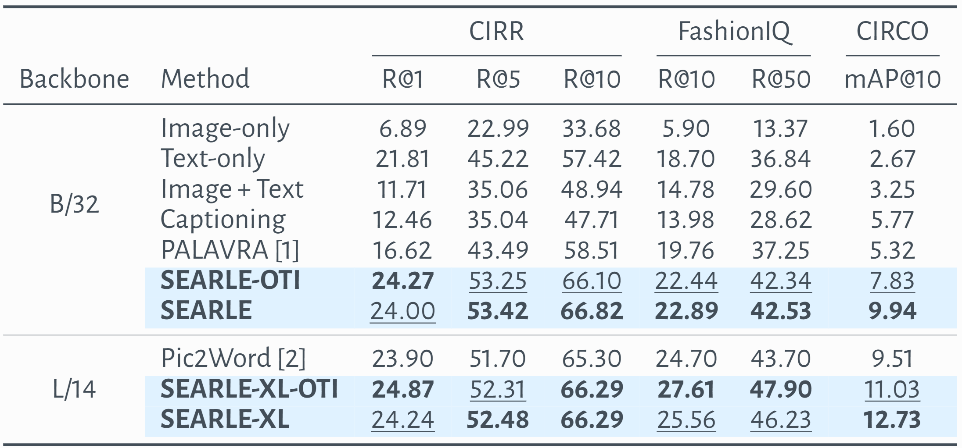
Results
📈 SEARLE is trained on just 3% of Pic2Word data.
[1] Cohen, Niv, et al. "“This is my unicorn, Fluffy”: Personalizing frozen vision-language representations." ECCV2022
[2] Saito, Kuniaki, et al. "Pic2word: Mapping pictures to words for zero-shot composed image retrieval." CVPR2023

Slide 38
Conclusions
Thanks for listening!
❌ Existing CIR approaches are limited by their reliance on expensive labeled dataset
💡 SEARLE tackles CIR without relying on a labeled training dataset
📈 SEARLE achieves state-of-the-art results
🎪 CIRCO is the first CIR dataset with multiple annotated ground-truths
Alberto Baldrati*
Lorenzo Agnolucci*
Marco Bertini
Alberto Del Bimbo
[name].[surname]@unifi.it
MICC – University of Florence, Italy

